Slide 1


Deep Learning
Olomouc, 22.1.2019
Thomas Evangelidis

Slide 2
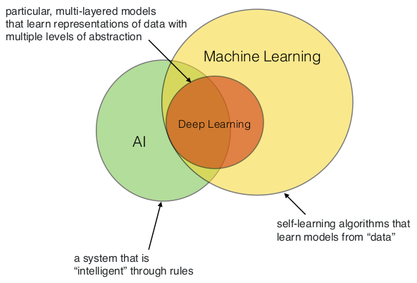
Relationship between machine learning, deep learning, and artificial intelligence.
Notes:
Note
that there is also overlap between Machine learning and data mining, data science, statistics, etc. (not shown).

Slide 3
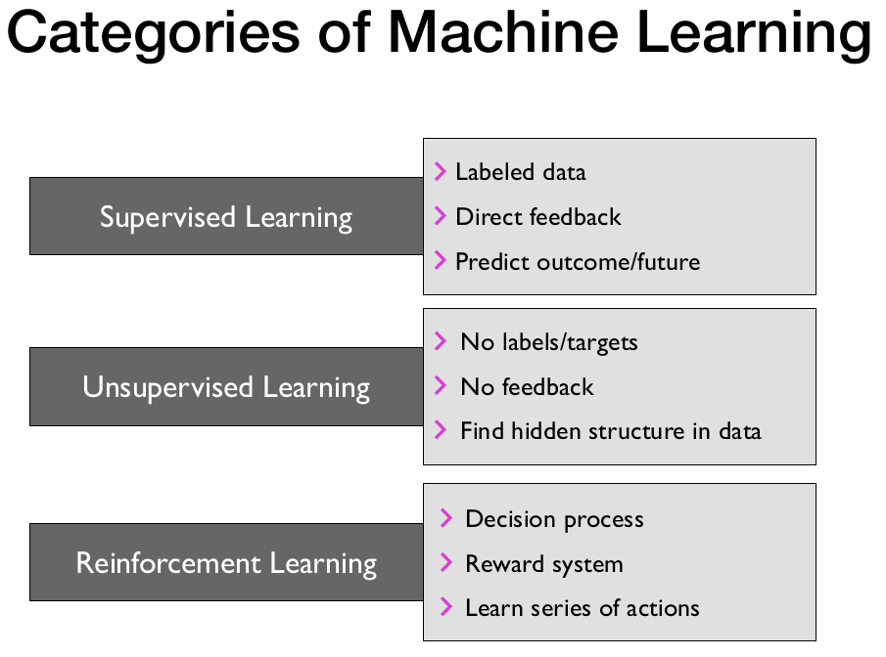

Slide 4
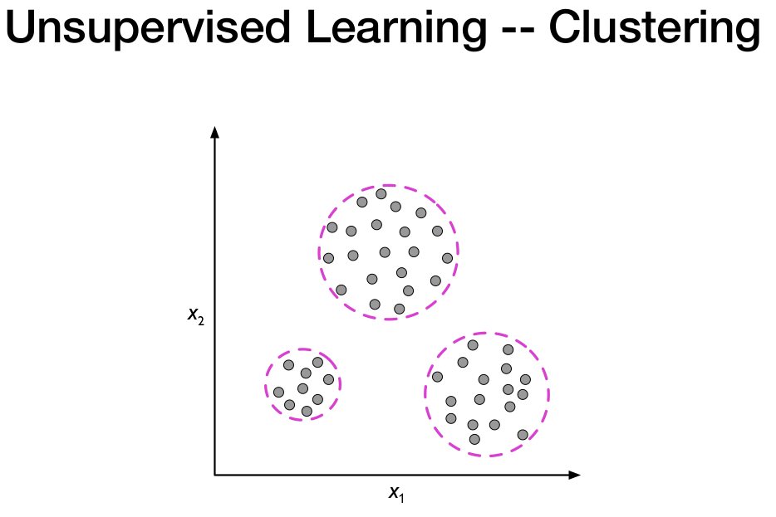
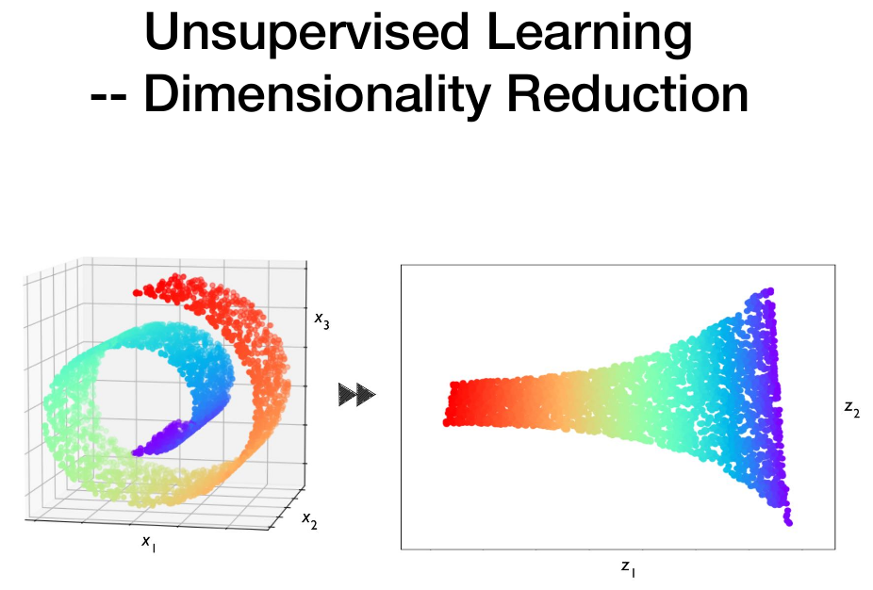
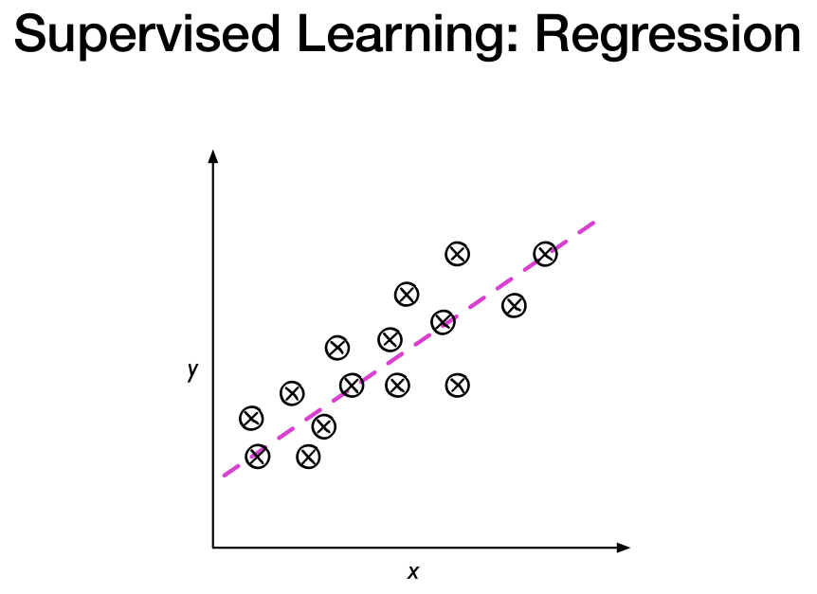
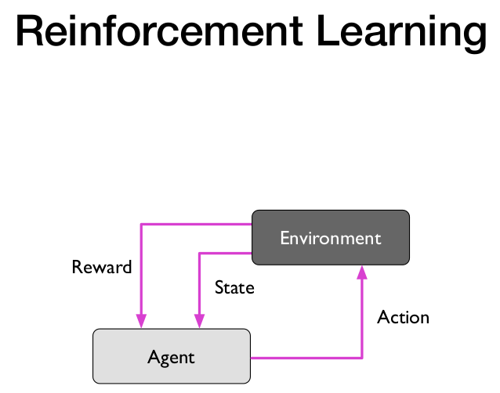
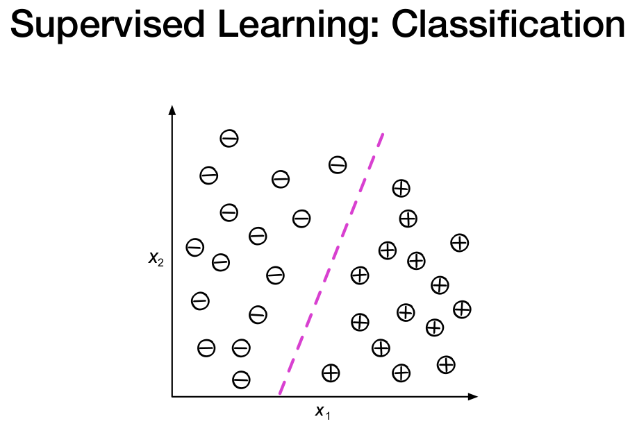
Notes:
What is reinforcement learning?

Slide 5
Which Neural Network Architectures will this presentation cover?
Multi-Layer Perceptron.
Autoencoders.
Recurrent Neural Networks (LSTM).
Convolutional Neural Networks.
Architectures that this presentation does not cover?
Generative Adversarial Networks
Deep Reinforcement Learning

Slide 6
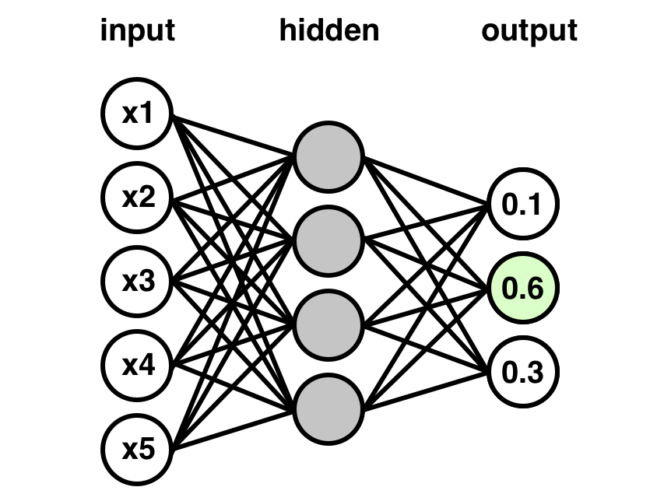
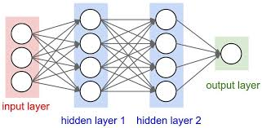
Neural Network Classifier vs Regressor
One output scalar value
One output value for each Class

Slide 7
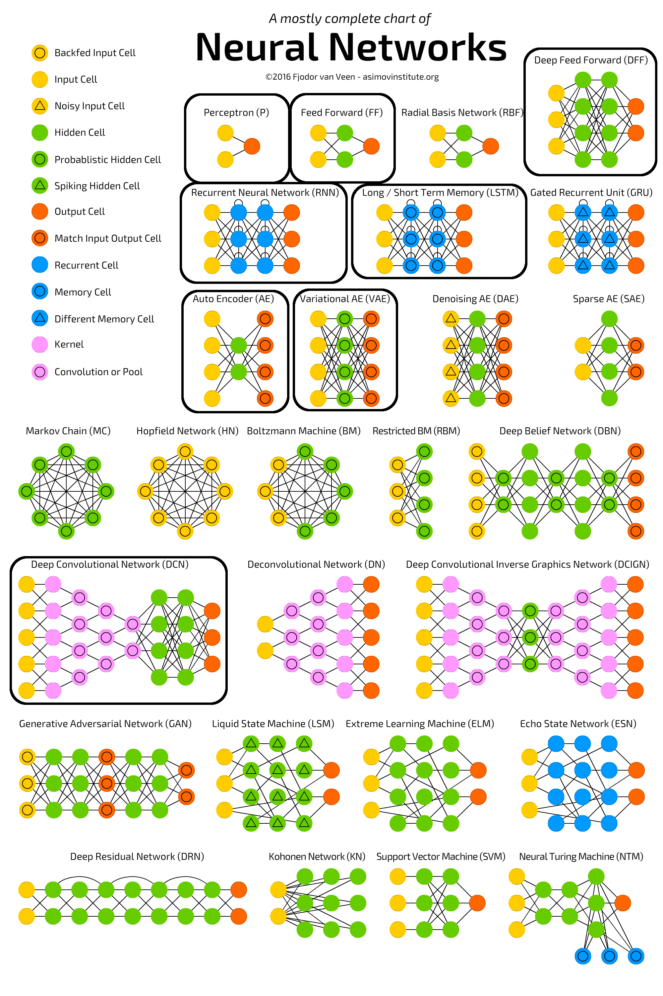

Slide 8
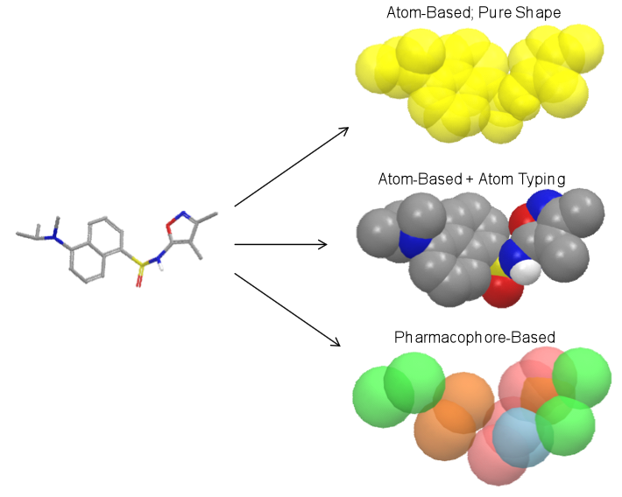
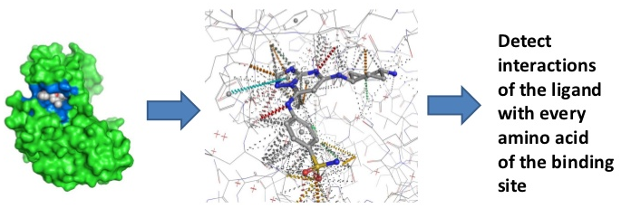
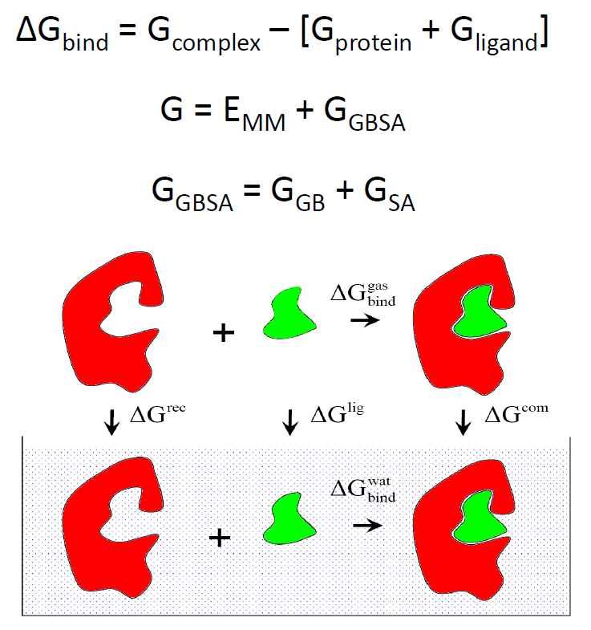
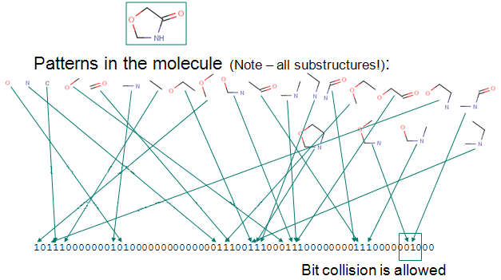
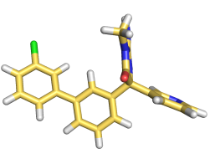
Feature Vectors
Vectorial representations of objects.
molecule
Feature
vectors
[-0.26, 0.7, -0.31, 0.65, 0.1, -0.48, 0.07, -0.14] [-54.43, -56.59, 67.49, -3.85, -14.8, -81.64, -2.54, -82.18] [0, 0, 0, 0, 0, 0, 1, 1] [17, 31, 14, 28, 5, 1, 23, 16]

Slide 9
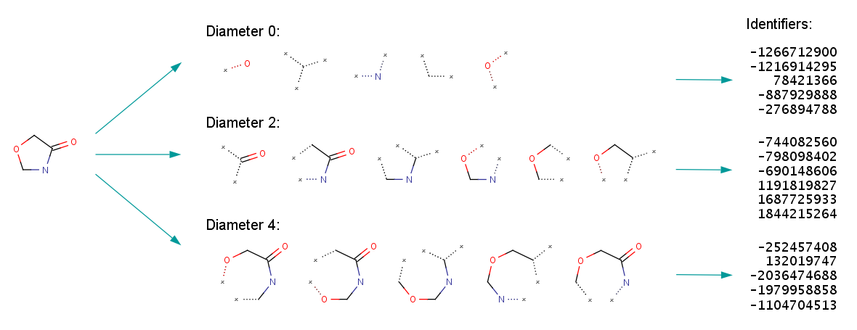
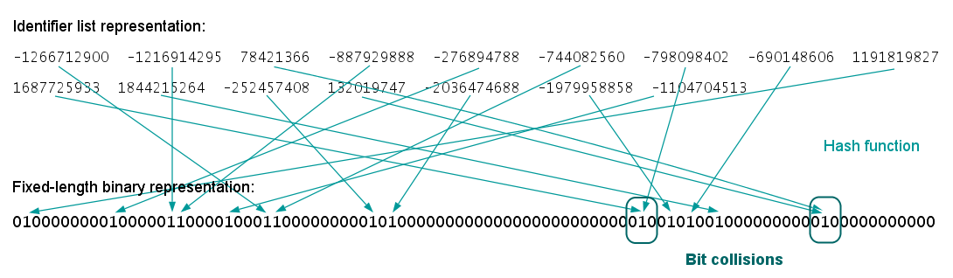
2D structure similarity fingerprint
Notes:
The fingerprint generation process is as follows:
Initial assignment of atom identifiers The ECFP generation process begins with the assignment of an initial integer identifier to each non-hydrogen atom of the input molecule. This identifier captures some local information about the corresponding atom in such a way that various atom properties (e.g., atomic number, connection count, etc.) are packed into a single integer value using a hash function. The set of considered atom properties is an important configuration parameter of ECFPs, which can be fully customized (see later).
Iterative updating of identifiers After that, a number of iterations are performed to combine the initial atom identifiers with identifiers of neighboring atoms until a specified diameter is reached. Each iteration captures larger and larger circular neighborhoods around each atom, which are then encoded into single integer values using a suitable hashing method and these identifiers are collected into a list.
If the identifier counts should be kept, then this step is modified to store each integer identifier as many times as the corresponding substructural feature occurs in the molecule. The final step of the generation process is the removal of multiple identifier representations of equivalent atom neighborhoods. Two neighborhoods are considered to be equivalent if they contain exactly the same set of bonds or their hashed integer identifiers are the same.
Duplication removal
If the identifier counts should be kept, then this step is modified to store each integer identifier as many times as the corresponding substructural feature occurs in the molecule. The final step of the generation process is the removal of multiple identifier representations of equivalent atom neighborhoods. Two neighborhoods are considered to be equivalent if they contain exactly the same set of bonds or their hashed integer identifiers are the same.
The following figures illustrate the whole ECFP generation process, including the derivation of the fixed length bit string from the identifier list representation.

Slide 10
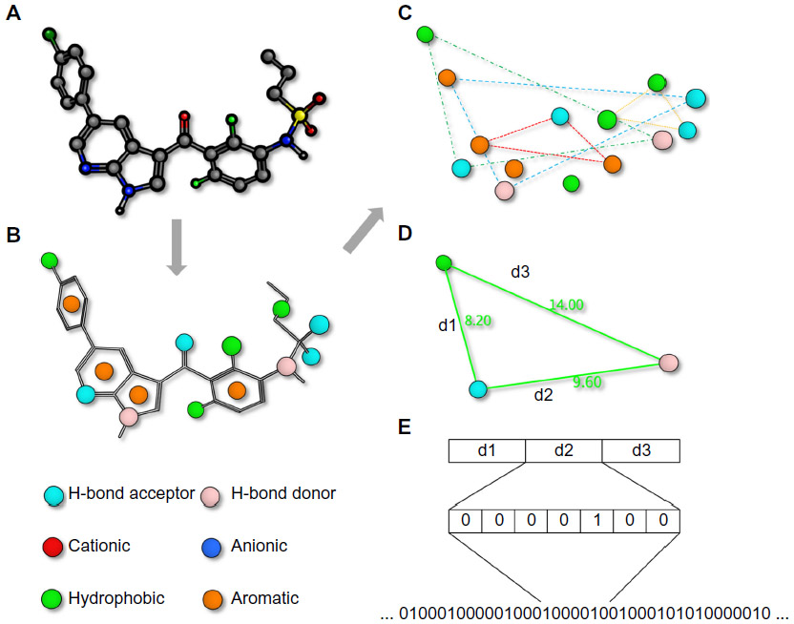
Pharmacophore fingerprints (2D or 3D)
Notes:
While molecules are 3D entities, the pharmacophore representation reduces a molecule to a collection of features at the 2D or 3D level.^{47,48} A pharmacophore fingerprint is an extension of this concept, and typically annotates a molecule as a unique data string. All possible three-point or four-point sets of pharmacophore features (points) are enumerated for each ligand.⁴⁹ The distance between the feature points is counted in bonds (for topological fingerprints), or by distance-binning when using 3D fingerprints (Figure 1). The resulting fingerprint is a string describing the frequency of every possible combination at predefined positions within the string. Several variants of pharmacophore fingerprints have been designed and are frequently used.
Notes: A pharmacophore fingerprint is the representation of a small molecule ligand (A) annotated with molecular interaction features (B) into a string. Typically, every possible three- (or four-) point combination of molecular interaction features (C), with different distances between the features, calculated either through space or by the number of bond lengths (D), is calculated and the frequency of occurrence is stored in a string (E). Such strings are useful for the easy comparison of similarity between multiple molecules.

Slide 11
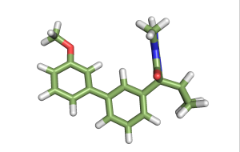
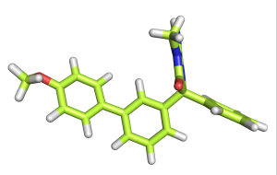
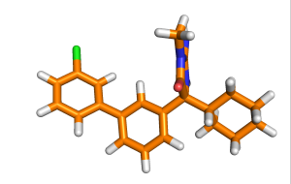
Training
molecules
Feature
vectors
[-0.26, 0.7, -0.31, 0.65, 0.1, -0.48, 0.07, -0.14] [-54.43, -56.59, 67.49, -3.85, -14.8, -81.64, -2.54, -82.18] [0, 0, 0, 0, 0, 0, 1, 1] [17, 31, 14, 28, 5, 1, 23, 16]
[0.56, -0.41, -0.71, -0.96, -0.02, -0.69, 0.59, 0.09] [89.83, 27.59, 27.12, 89.86, -74.75, 26.72, 70.62, 80.74] [1, 0, 0, 1, 1, 1, 1, 0] [2, 32, 28, 26, 40, 6, 6, 40]
[0.87, -0.59, 0.94, 0.42, 0.36, -0.18, -0.74, 0.81] [-38.56, -37.32, 39.61, -96.2, -89.24, 51.3, -87.78, -92.43] [1, 0, 0, 1, 1, 0, 1, 1] [14, 38, 36, 24, 1, 19, 32, 1]
[-0.69, -0.78, 0.39, -0.58, -0.57, -0.43, 0.91, -0.91] [-56.5, 59.78, 32.95, -50.06, 56.94, 22.54, -33.36, -9.05] [0, 0, 1, 1, 1, 1, 1, 0] [20, 25, 16, 15, 35, 34, 20, 13]

Slide 12
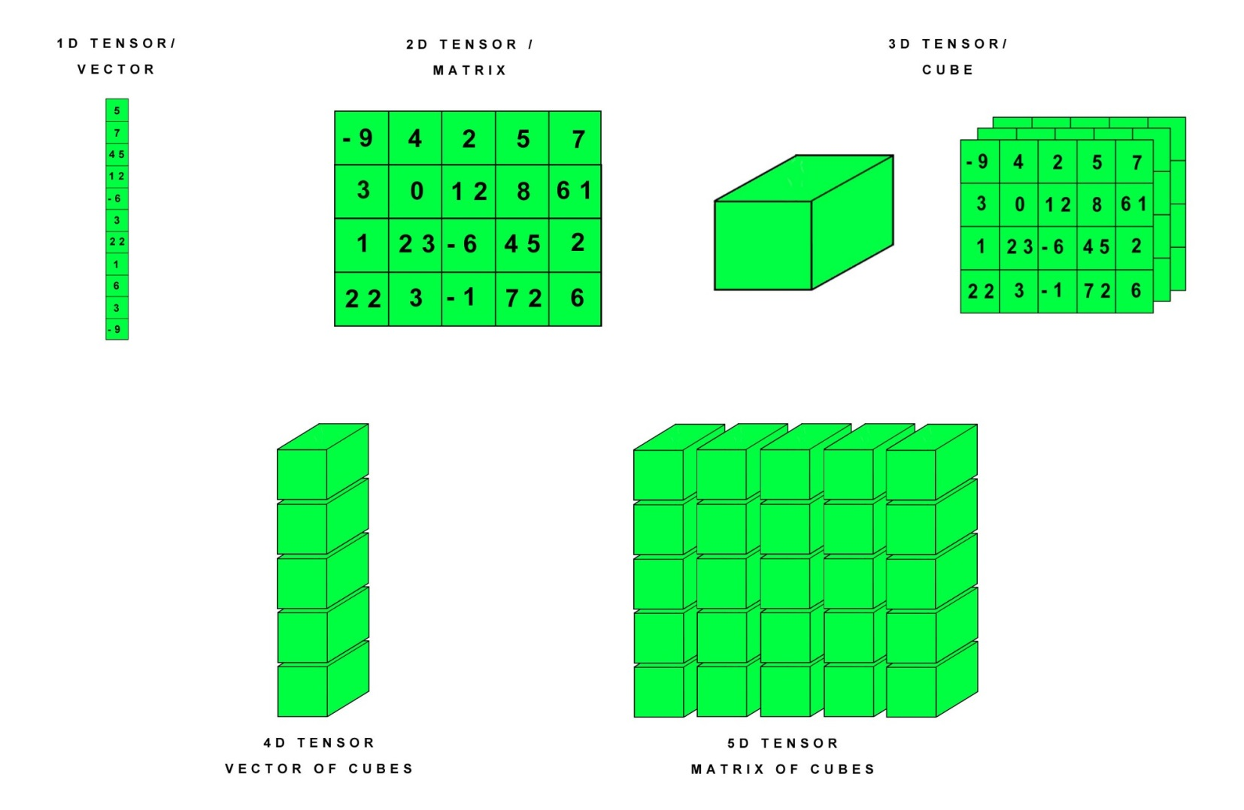
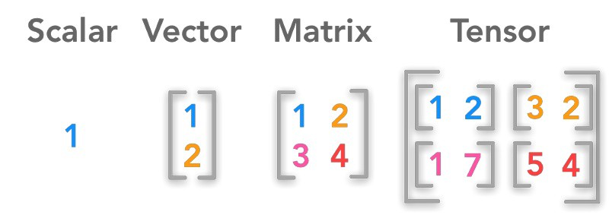
In Deep Learning we use Tensors

Slide 13
Important Components of a Neural Network apart from the neurons.
Activation functions. Transforms the sum of weights and biases of each layer – adds non-linearity to the model.
Loss function (aka Cost function, Objective function, Error function). Measures how well the NN reproduces the experimental training data.
Optimization algorithm. Finds weights and bias values that minimize (locally) the Loss function.
Regularization technique. Prevents over-fitting of the NN to the training data.

Slide 14
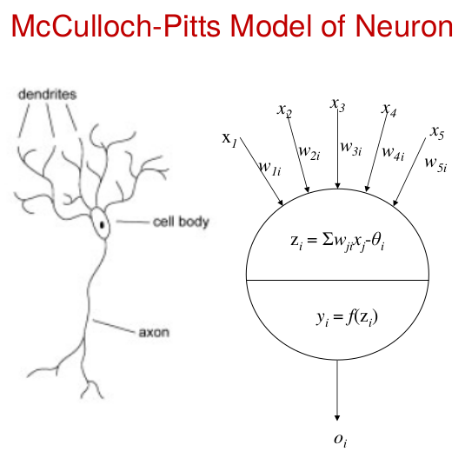
Weighted sum of features x₁₋₅
Activation Function

Slide 15
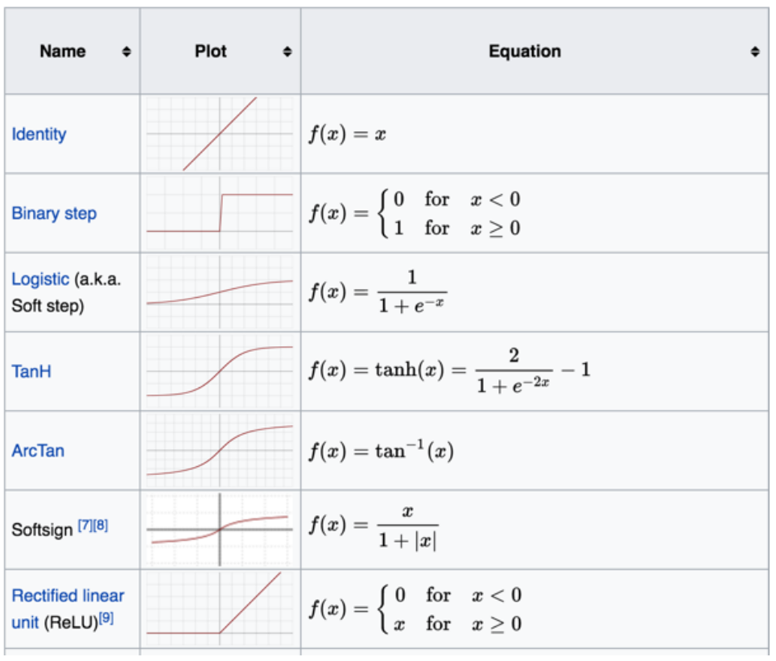
Activation Functions
Sigmoid
Notes:
tanh = hyperbolic tangent

Slide 16
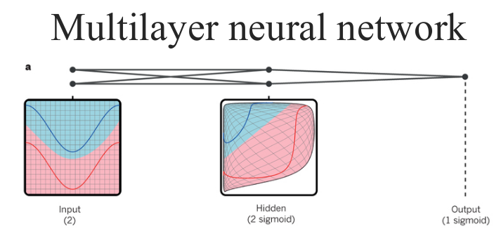
A multilayer neural network (shown by the connected dots) can distort the input space to make the classes of data (examples of which are on the red and blue lines) linearly separable. Note how a regular grid (shown on the left) in input space is also transformed (shown in the middle panel) by hidden units. This is an illustrative example with only two input units, two hidden units and one output unit, but the networks used for object recognition or natural language processing contain tens or hundreds of thousands of units. Reproduced with permission from C. Olah (http://colah.github.io/).

Slide 17
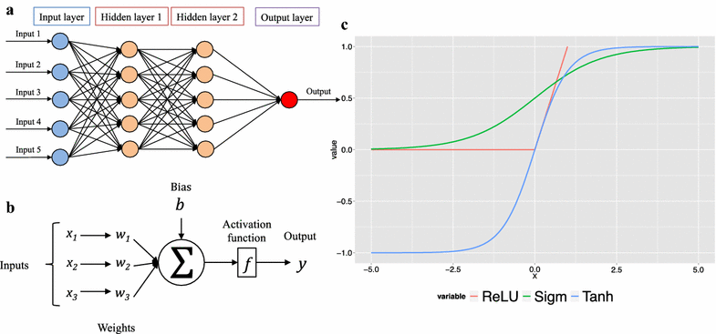
Multilayer Perceptron (deep feed forward network) outline
a A feed-forward deep neural network with two hidden layers, each layer consists of multiple neurons, which are fully connected with neurons of the previous and following layers. b Each artificial neuron receives one or more input signals x 1, x 2,…, x m and outputs a value y to neurons of the next layer. The output y is a nonlinear weighted sum of input signals. Nonlinearity is achieved by passing the linear sum through non-linear functions known as activation functions. c Popular neurons activation functions: the rectified linear unit (ReLU) (red), Sigmoid (Sigm) (green) and Tanh (blue)
Notes:
Deep neural networks are typically trained, by updating and adjusting neurons weights and biases, utilizing the supervised learning back-propagation algorithm in conjunction with optimization technique such as stochastic gradient descent [29, 30]. Regularization techniques, such as Dropout, were introduced to reduce over-fitting and improve generalization [31]. Dropout regularization technique was proposed to address the problem of over-fitting by preventing neurons co-adaption. Recent advances in GPU computing capabilities has allowed complex deep learning architecture to be trained in reasonable amount of time [32].
Koutsoukas A. et al., Journal of Cheminformatics 2017 9:42

Slide 18
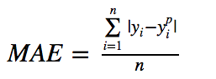
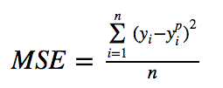
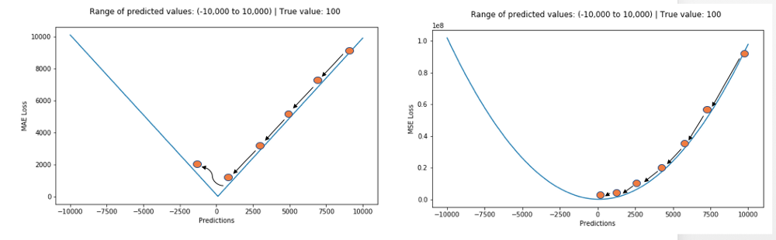
Loss Functions for Regression
Mean Absolute Error (aka L1).
Mean Squared Error (aka L2).
MAE is more robust to outliers but its derivatives are not continuous making it inefficient to find minima.
MSE is sensitive to outliers but easier to find minima.
Other Cost functions that even out the disadvantages of MAE & MSE: Huber Loss, Log-Cosh Loss, Quantile Loss.
More at https://heartbeat.fritz.ai/5-regression-loss-functions-all-machine-learners-should-know-4fb140e9d4b0

Slide 19
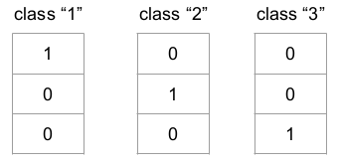
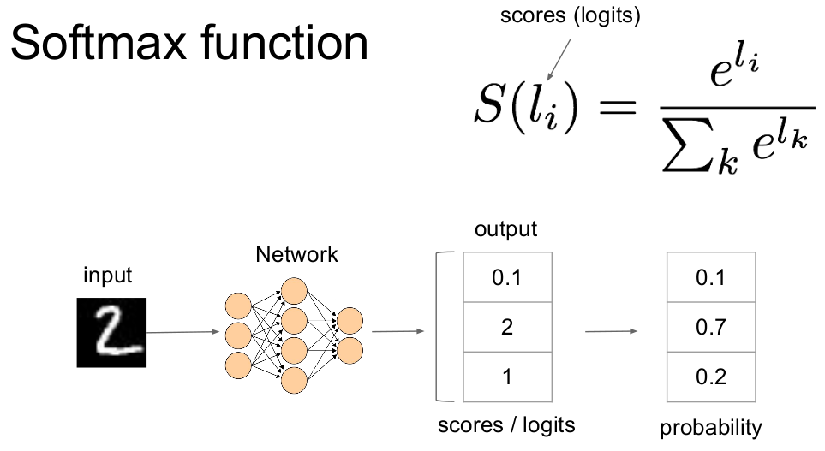
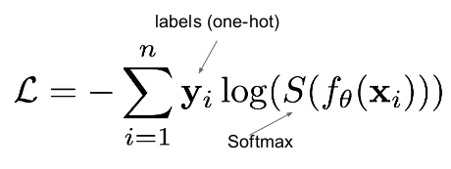
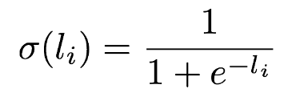
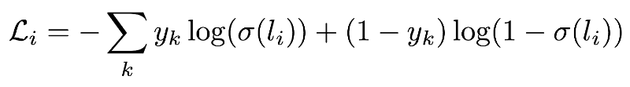
Loss Functions for Classification
One-hot encoding. Tansforms each label into a vector (1 for correct class, 0 otherwise)
converts the scores to probabilities.
Cross Entropy Loss/Negative Log Likelihood (the most frequently used). Increases as the predicted probability diverges from the actual label and penalizes heavily the predictions that are confident but wrong.
Sigmoid function
S =
For multi-label classification (outputs can be matched to more than one label, e.g. ‘car’, ‘automobile’ can be applied to same image of car).

Slide 20
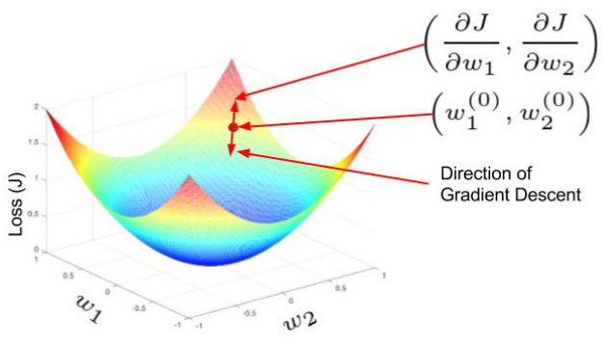
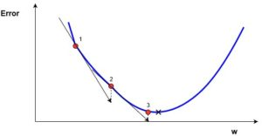
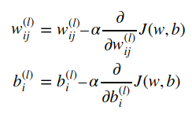
Optimization Algorithm
In training the goal is to get the neural network better and better at predicting the correct y given x. This is performed by varying the weights so as to minimize the error.
One-dimensional gradient descent
Two-dimensional gradient descent
The gradient descent method uses the gradient to make an informed step change in w to lead it towards the minimum of the error curve. This is an iterative method, that involves multiple steps. Each time, the w value is updated according to:
The minimum possible error is marked by the black cross, but we don’t know what ww value gives that minimum error. We start out at a random value of ww, which gives an error marked by the red dot on the curve labelled with “1”. We need to change ww in a way to approach that minimum possible error, the black cross. One of the most common ways of approaching that value is called gradient descent.
Notes:
Here wnew denotes the new w position, wold denotes the current or old w position, ∇error is the gradient of the error at wold and α is the step size. The step size α will determine how quickly the solution converges on the minimum error.

Slide 21
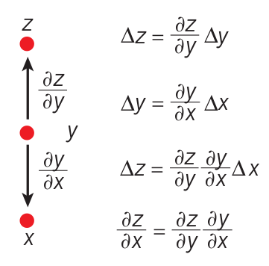
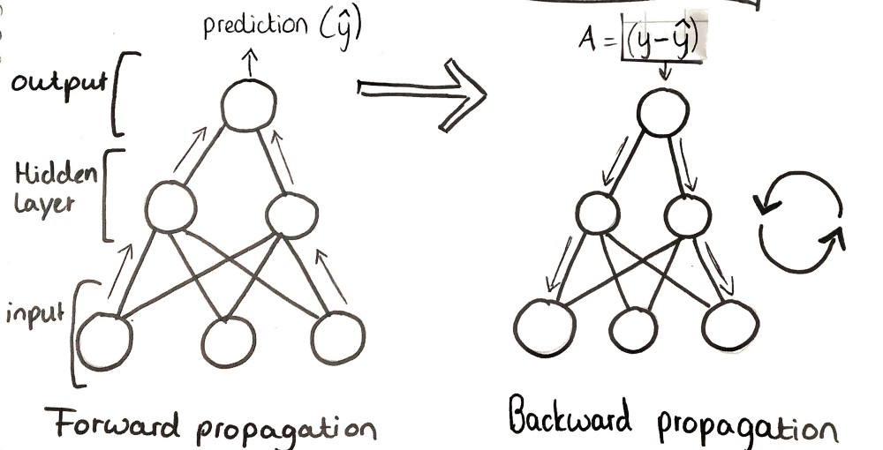
Learning with Backpropagation: the Chain Rule
The chain rule of derivatives tells us how two small effects (that of a small change of x on y, and that of y on z) are composed. A small change Δx in x gets transformed first into a small change Δy in y by getting multiplied by ∂y/∂x (that is, the definition of partial derivative). Similarly, the change Δy creates a change Δz in z. Substituting one equation into the other gives the chain rule of derivatives - how Δx gets turned into Δz through
multiplication by the product of ∂y/∂x and ∂z/∂x. It also works when x, y and z are vectors (and the derivatives are Jacobian matrices).
LeCun et al., Nature 2015, 521, 436–444.

Slide 22
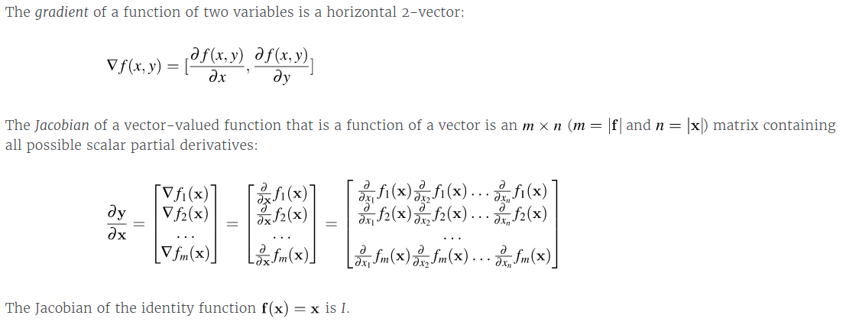
Gradients and Jacobians

Slide 23
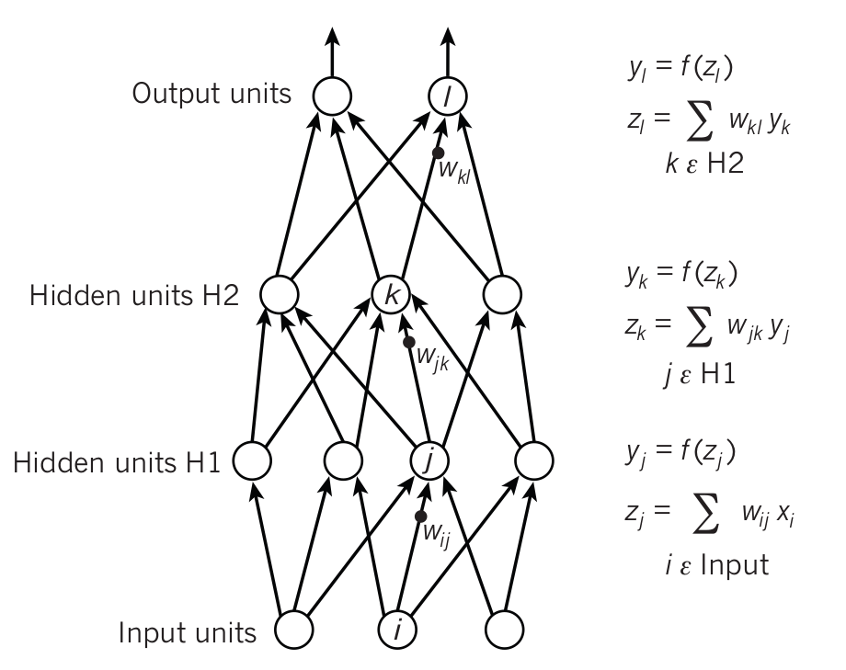
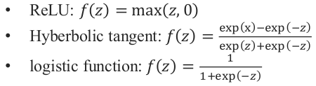
Learning with Backpropagation: stage 1
The equations used for computing the forward pass in a neural net with two hidden layers and one output layer, each constituting a module through which one can backpropagate gradients.
At each layer, we first compute the total input z to each unit, which is a weighted sum of the outputs of the units in the layer below. Then a non-linear function f(z) is applied to z to get the output of the unit. For simplicity, we have omitted bias terms. Some non-linear functions used in neural networks:
LeCun et al., Nature 2015, 521, 436–444.

Slide 24
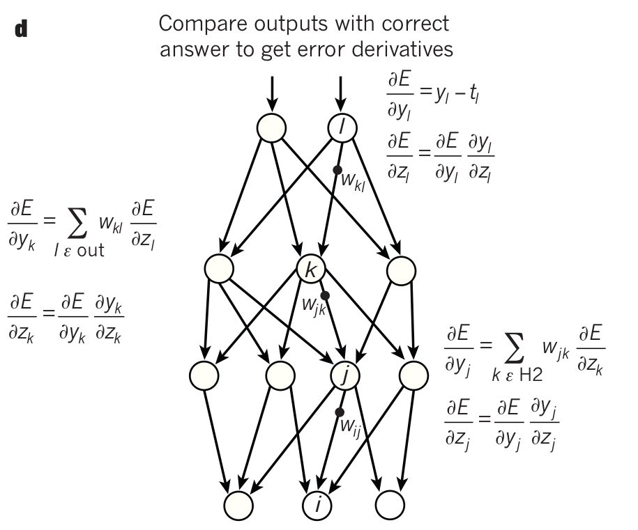
Learning with Backpropagation: stage 2
The equations used for computing the backward pass. At each hidden layer we compute the error derivative with respect to the output (∂E/∂y_{l}) of each unit, which is a weighted sum of the error derivatives with respect to the total inputs to the units in the layer above.
We then convert the error derivative with respect to the output into the error derivative with respect to the input (∂E/∂z_{k}) by multiplying it by the gradient of f(z).
At the output layer, the error derivative with respect to the output of a unit is computed by differentiating the cost function. This gives y_{l}-t_{l} if the cost function for unit l is 0.5(y_{l}-t_{l})² , where t_{l} is the target value. Once the ∂E/∂z_{k} is known, the error-derivative for the weight w_{jk} on the connection from unit j in the layer below is just y_{j} ∂E/∂z_{k} .
LeCun et al., Nature 2015, 521, 436–444.

Slide 25
Back propagation
Back propagation learning algorithm is widely used for multi-layer feed forward networks. This uses gradient descent as well.
Great example of back propagation: https://www.youtube.com/watch?v=8d6jf7s6_Qs&list=PLnZ8rft3-N1lIZnHz6NbaNiXhXzgncG9J&t=0s&index=7
The Matrix Calculus You Need For Deep Learning:
https://explained.ai/matrix-calculus/index.html

Slide 26
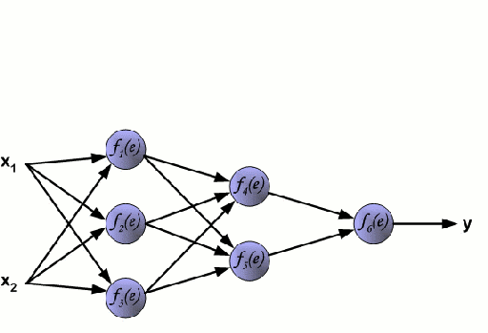
Notes:
BACKWARD PROPAGATION: calculates the gradient of a loss function.

Slide 27
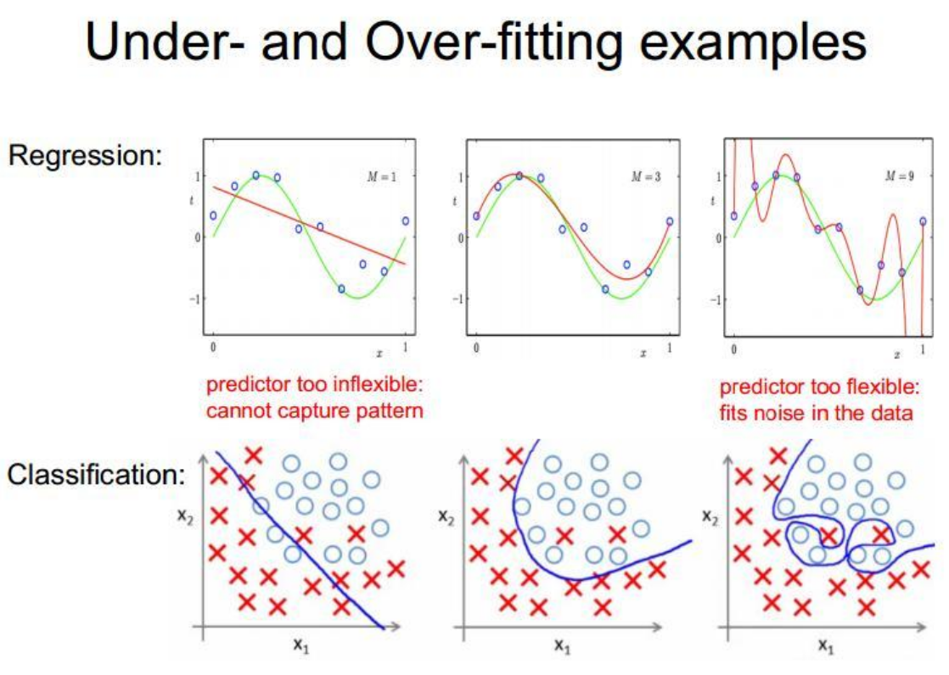
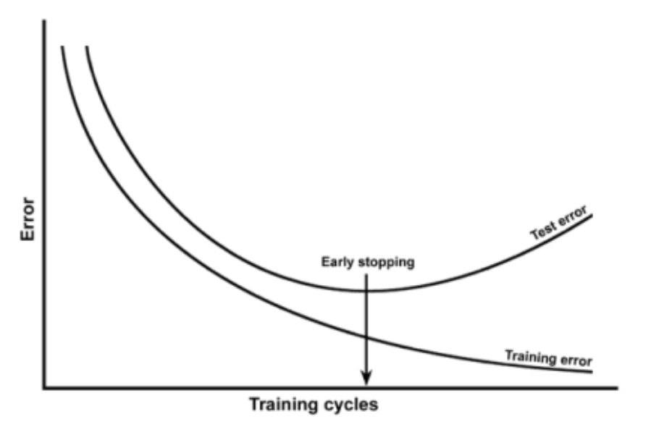
When to stop training?

Slide 28
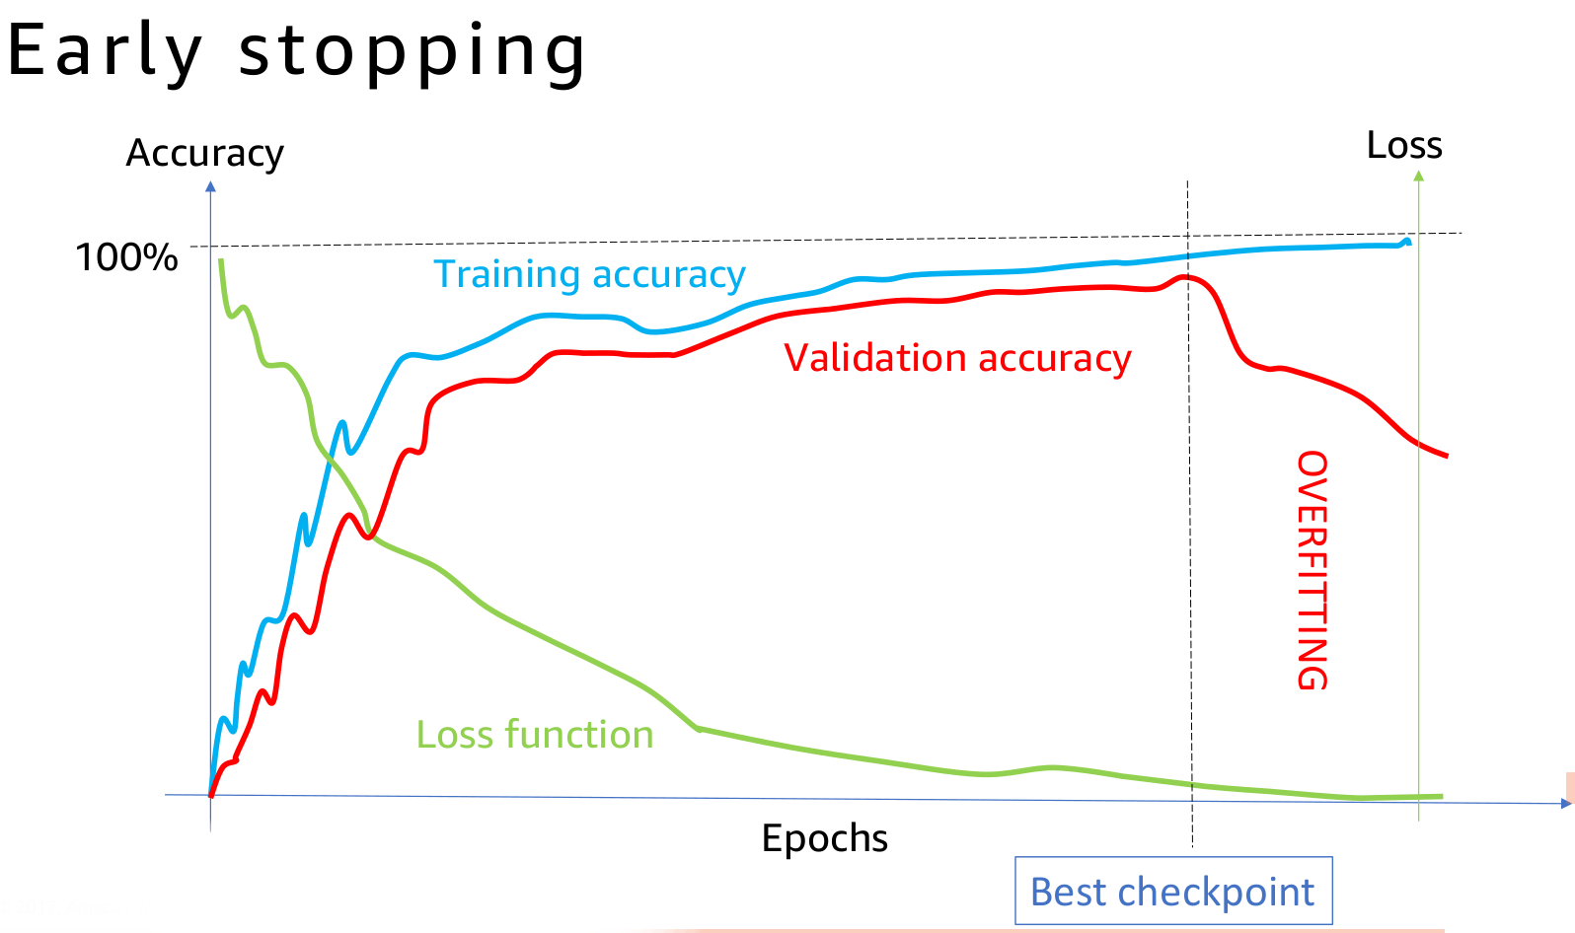
When to stop training?

Slide 29
Lets train a simple network live!
http://playground.tensorflow.org

Slide 30
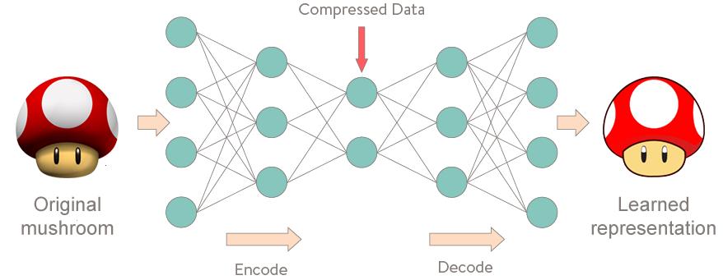
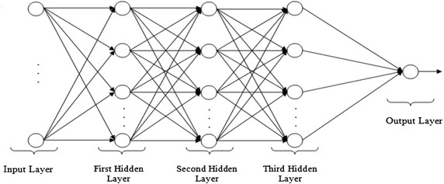
Autoencoders
Which differences can you spot between the autoencoder ↑ and the MLP Regressor → ?

Slide 31

Autoencoders
3rd neural network connected to the latent-space that correlates to the property of the molecule (drug-likeness, synthetic accessibility, etc.).
Gomez-Bombarelli et al., 2016
Chemical space is discrete which makes it hard to search with standard techniques such as gradient-based minimization. The autoencoder maps molecules into a (compressed) latent space (a), which is continuous and can be connected to another network that relates the structures to chemical properties (b). The algorithm can then explore the chemical space it has mapped out to find molecules with the desired properties. A decoder maps a molecule from the compressed representation back to the original, but often degenerated. Autoencoders are used for data denoising and dimensionality reduction.

Slide 32

Recurrent Neural Networks (RNNs)
In a Feed-Forward neural network, the information only moves in one direction, from the input layer, through the hidden layers, to the output layer.
In a RNN, the information cycles through a loop. When it makes a decision, it takes into consideration the current input and also what it has learned from the inputs it received previously. Therefore a RNN has two inputs, the present and the recent past. This is important because the sequence of data contains crucial information about what is coming next, which is why a RNN can do things other algorithms can’t.

Slide 33

Recurrent Neural Networks (RNNs)

Slide 34
What RNNs ca do?
Language modeling and generating text.
Machine translation.
Speech recognition and generation
Generating image descriptions
Time series processing
Movies and video clips processing
Music classification and generation
Choreography
….
Bioinformatics (DNA, RNA, proteins, peptides)
Chemoinformatics (SMILES strings)

Slide 35


Recurrent Neural Networks (RNNs)
A very simple RRN.
The number of times that you unroll can be consider how far in the past the network will remember. In other words each time is a time-step.

Slide 36


RNNs
The repeating module in a RNN contains a single (tanh) layer.
One to one: Normal Forward network, ie: Image on the input, label on the output
One to many(RNN): (Image captioning) Image in, words describing the scene out (CNN regions detected + RNN)
Many to one(RNN): (Sentiment Analysis) Words on a phrase on the input, sentiment on the output (Good/Bad) product.
Many to many(RNN): (Translation), Words on English phrase on input, Czech on output.
Many to many(RNN): (Video Classification) Video in, description of video on output.

Slide 37

To get from x_{t-3} to x_{t-2} we multiply x_{t-3} by w_{rec} (“weight recurring“, connects the hidden layers to themselves). Then, to get from x_{t-2} to x_{t-1} we again multiply x_{t-2} by w_{rec}. So, we multiply with the same exact weight multiple times, and this is where the problem arises: when you multiply something by a small number, your value decreases very quickly.
As a result, weights of the layers on the very far left are updated much slower than the weights of the layers on the far right. This creates a domino effect because the weights of the far-left layers define the inputs to the far-right layers.The lower the gradient is, the harder it is for the network to update the weights and the longer it takes to get to the final result.
Notes:
Basically, during the training, your cost function compares your outcomes (red circles on the image below) to your desired output.
As a result, you have these values throughout the time series, for every single one of these red circles.
You’ve calculated the cost function e_{t}, and now you want to propagate your cost function back through the network because you need to update the weights.
Essentially, every single neuron that participated in the calculation of the output, associated with this cost function, should have its weight updated in order to minimize that error. And the thing with RNNs is that it’s not just the neurons directly below this output layer that contributed but all of the neurons far back in time. So, you have to propagate all the way back through time to these neurons.
As we know, weights are assigned at the start of the neural network with the random values, which are close to zero, and from there the network trains them up. But, when you start with w_{rec} close to zero and multiply x_{t}, x_{t-1}, x_{t-2}, x_{t-3}, … by this value, your gradient becomes less and less with each multiplication.

Slide 38
Long Short Term Memory (LSTM) Networks
The units of an LSTM are used as building units for the layers of a RNN.
LSTM’s enable RNN’s to remember their inputs over a long period of time. This is because LSTM’s contain their information in a memory, that is much like the memory of a computer because the LSTM can read, write and delete information from its memory.
This memory can be seen as a gated cell, where gated means that the cell decides whether or not to store or delete information (e.g. if it opens the gates or not), based on the importance it assigns to the information. The assigning of importance happens through weights, which are also learned by the algorithm. This simply means that it learns over time which information is important and which not.
LSTMs do not suffer from vanishing or exploding gradients.

Slide 39



LSTM temporal repeating unit
Input gate layer
Cell state
(c_{t-1})
Hidden state
(h_{t-1})
Output gate layer
Forget gate layer
The repeating module in LSTM contains 4 interacting layers.
c_{t-1} stands for the input from a memory cell in time point t;
x_{t} is an input in time point t;
h_{t} is an output in time point t that goes to both the output layer and the hidden layer in the next time point.
Thus, every block has three inputs (x_{t}, h_{t-1}, and c_{t-1}) and two outputs (h_{t} and c_{t}).
Gates are structures that can remove or add information to the cell state. They are composed out of a sigmoid neural net layer and a pointwise multiplication operation. LSTM has three of these gates, to protect and control the cell state.
Gate

Slide 40

How does a deep LSTM Network look like?
Deep LSTM network with 3 LSTM layers (green) and two feedforward layers (yellow). For clarity, the temporal recurrent structure is not shown.

Slide 41

Untuitive example
When we change the word “boy” to “girl” in the English sentence, the Czech translation has two additional words changed because in Czech the verb form depends on the subject’s gender.
Find the mistakes!

Slide 42

Convolutional Deep Neural Networks
Images can be represented as feature tensors and become the input to DNNs.

Slide 43

Convolutional Neural Networks (CNNs)
CNNs have two components:
1. The Hidden layers/Feature extraction part
In this part, the network will perform a series of convolutions and max pooling operations during which the features are detected. If you had a picture of a zebra, this is the part where the network would recognize its stripes, two ears, and four legs.
2. The Classification part
Here, the fully connected (FC) layers will serve as a classifier on top of these extracted features. They will assign a probability for the object on the image being what the algorithm predicts it is.

Slide 44

Convolutional Deep Neural Networks
How do they look like?

Slide 45



Convolutional Neural Networks (CNNs)
The most important component of CNNs are the convolution layers. Imagine a 32x32x3 image if we convolve this image with a 5x5x3 filter, aka kernel (the filter depth must have the same depth as the input), the result will be an activation map 28x28x1.
Convolutional layer with 6 kernels
Each filter focuses on specific patterns in the image (e.g. vertical edges, holizontal edges, colors, etc.) and produces a new mapping of the image named activation or feature map, which is something equivalent to the feature vectors we have seen.
Notes:
Feature vector is vectorial representation of objects. For example, a car can be represented by [number of wheels, door. windows, age ..etc].
Filter (aka kernel) is a function that takes feature vectors in one space and transforms them into feature vectors in another. For example given a feature vector [volume ,weight, height, width] it can return [1, volume/weight, height * width] or [height * width] or even just [volume]
Feature map and activation map mean exactly the same thing. It is called an activation map because it is a mapping that corresponds to the activation of different parts of the image, and also a feature map because it is also a mapping of where a certain kind of feature is found in the image. A high activation means a certain feature was found.
A "rectified feature map" is just a feature map that was created using Relu. You could possibly see the term "feature map" used for the result of the dot products because this is also really a map of where certain features are in the image, but that is not common to see.

Slide 46

Convolutional Deep Neural Networks
Chemical Deep Learning extracts features from the molecule going from the simple, to the abstract to the specific.
[Implementation of the “Chemception”, courtesy of https://www.wildcardconsulting.dk]

Slide 47


Layer 7
Kernel 5: seems to focus on bonds, as it has removed the bond information when there were atoms in the other layers.
Kernel 1: focuses on atoms and is most activated for aliphatic carbon.
Kernel 4: is most exited with the chlorine atoms, but also contain bond information.
Kernel 2 and 3: seem empty. Maybe they are activated by other molecules on features not present in the current molecule, or maybe they were unneeded.
Lets go deeper....

Slide 48

Layer 11

Slide 49

Layer 13

Slide 50

Layer 15

Slide 51

Layer 19
Kernels 0 to 2 seem to focus on all that is not the chlorine atoms. Kernel 5 is activated near the double bonded oxygens.

Slide 52

Layer 20
This last layer before max pooling only seems to focus on very specific parts of the molecule. Kernel 0 could be the amide oxygen. Kernel 2 and 5 the chlorine atoms. Kernel 4 seem to like the double bonded oxygens, but only from the carboxylic acid groups, not the amide. Kernel 3 gets activated near the terminal carboxylic acid’s OH.
Notes:
A general trend as we go through the layers is the more and more abstract and specific features that are created. The chlorine atoms seem to light up in a lot of the kernels, but others focus on other features. These are only the first 6 of the features (kernels 0-6) that are extracted from the images and fed forward to the dense layer

Slide 53




Convolution & Max Pooling operations
Left: the filter (green) slides over the input image. Right: the result is summed and added to the feature map (convolved image).
The filter slides over the input and performs its output on the new layer.
Max pooling takes the largest values.
Notes:
Kernel == filter

Slide 54

Convolutional Neural Networks
The fully connected layer (FC) operates on a flattened input where each input is connected to all the neurons. These are usually used at the end of the CNN to connect the hidden layers to the output layer, which help in optimizing the class scores.

Slide 55
Convolutional Deep Neural Networks
How do they look like?

Slide 56

Conclusions
Deep learning is preferable:
Very high predictive performance in domains with huge amounts of labelled data (vision, speech, texts, etc)
Scales effectively with data
No need for feature engineering (can handle unstructured data)
Adaptable and transferable
Classical machine learning is preferable:
Works better on small and/or noisy data
Computationally and financially cheaper
Easier to interpret

Slide 57
References
Excellent theoretical introduction the NNs and python implementations: http://adventuresinmachinelearning.com/neural-networks-tutorial/
Excellent theoretical and practical introduction to Recurrent Neural Networks:
http://adventuresinmachinelearning.com/neural-networks-tutorial/
RNNs and the Vanishing Gradient problem:
https://www.superdatascience.com/recurrent-neural-networks-rnn-the-vanishing-gradient-problem/
LSTM networks:
http://colah.github.io/posts/2015-08-Understanding-LSTMs/
CNNs:
https://medium.freecodecamp.org/an-intuitive-guide-to-convolutional-neural-networks-260c2de0a050
Great book with simple, illustrated explanations of Deep Learning:
https://leonardoaraujosantos.gitbooks.io/artificial-inteligence/content/chapter1.html

